Slide 1
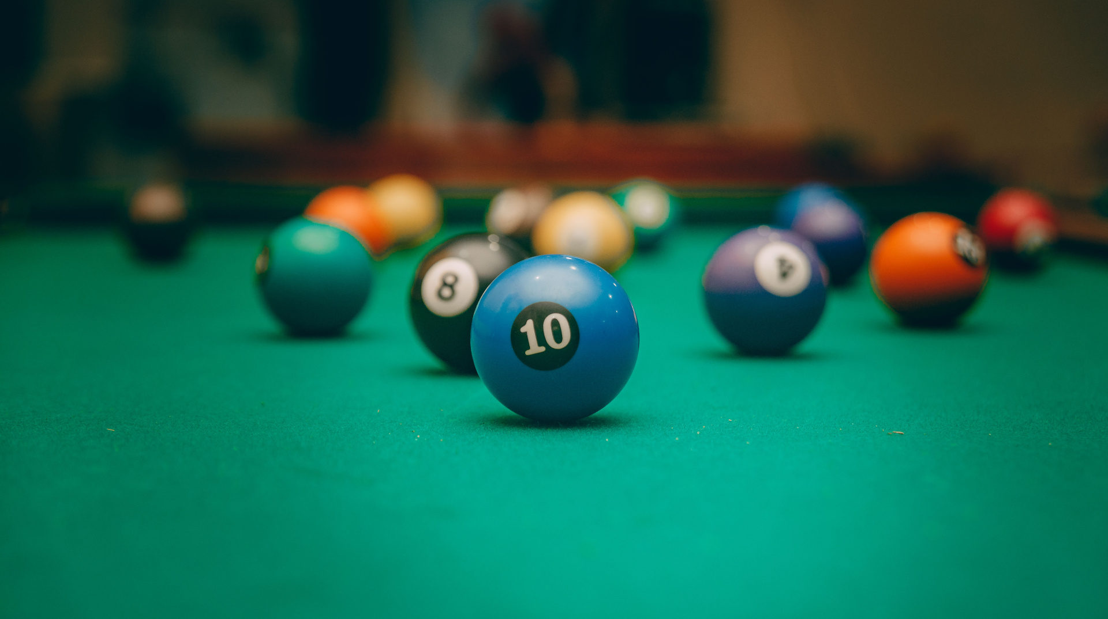
Billiard
By George Ayoub and Amjad Shehadeh

Slide 2

Game Rules:
Winning:
Getting all three balls (red, blue and black) into the holes within 170 seconds.
Losing:
Getting the white ball into a hole.
Not getting the other balls into holes
before timer ends.

Slide 3
Essential:
- Balls move with friction in a billiard table with 6 holes.
- The balls move up, down, right and left
Creativity:
Sound added
2 balls more than the essential requirement.
Score
Starting and ending screens
Timer

Slide 4

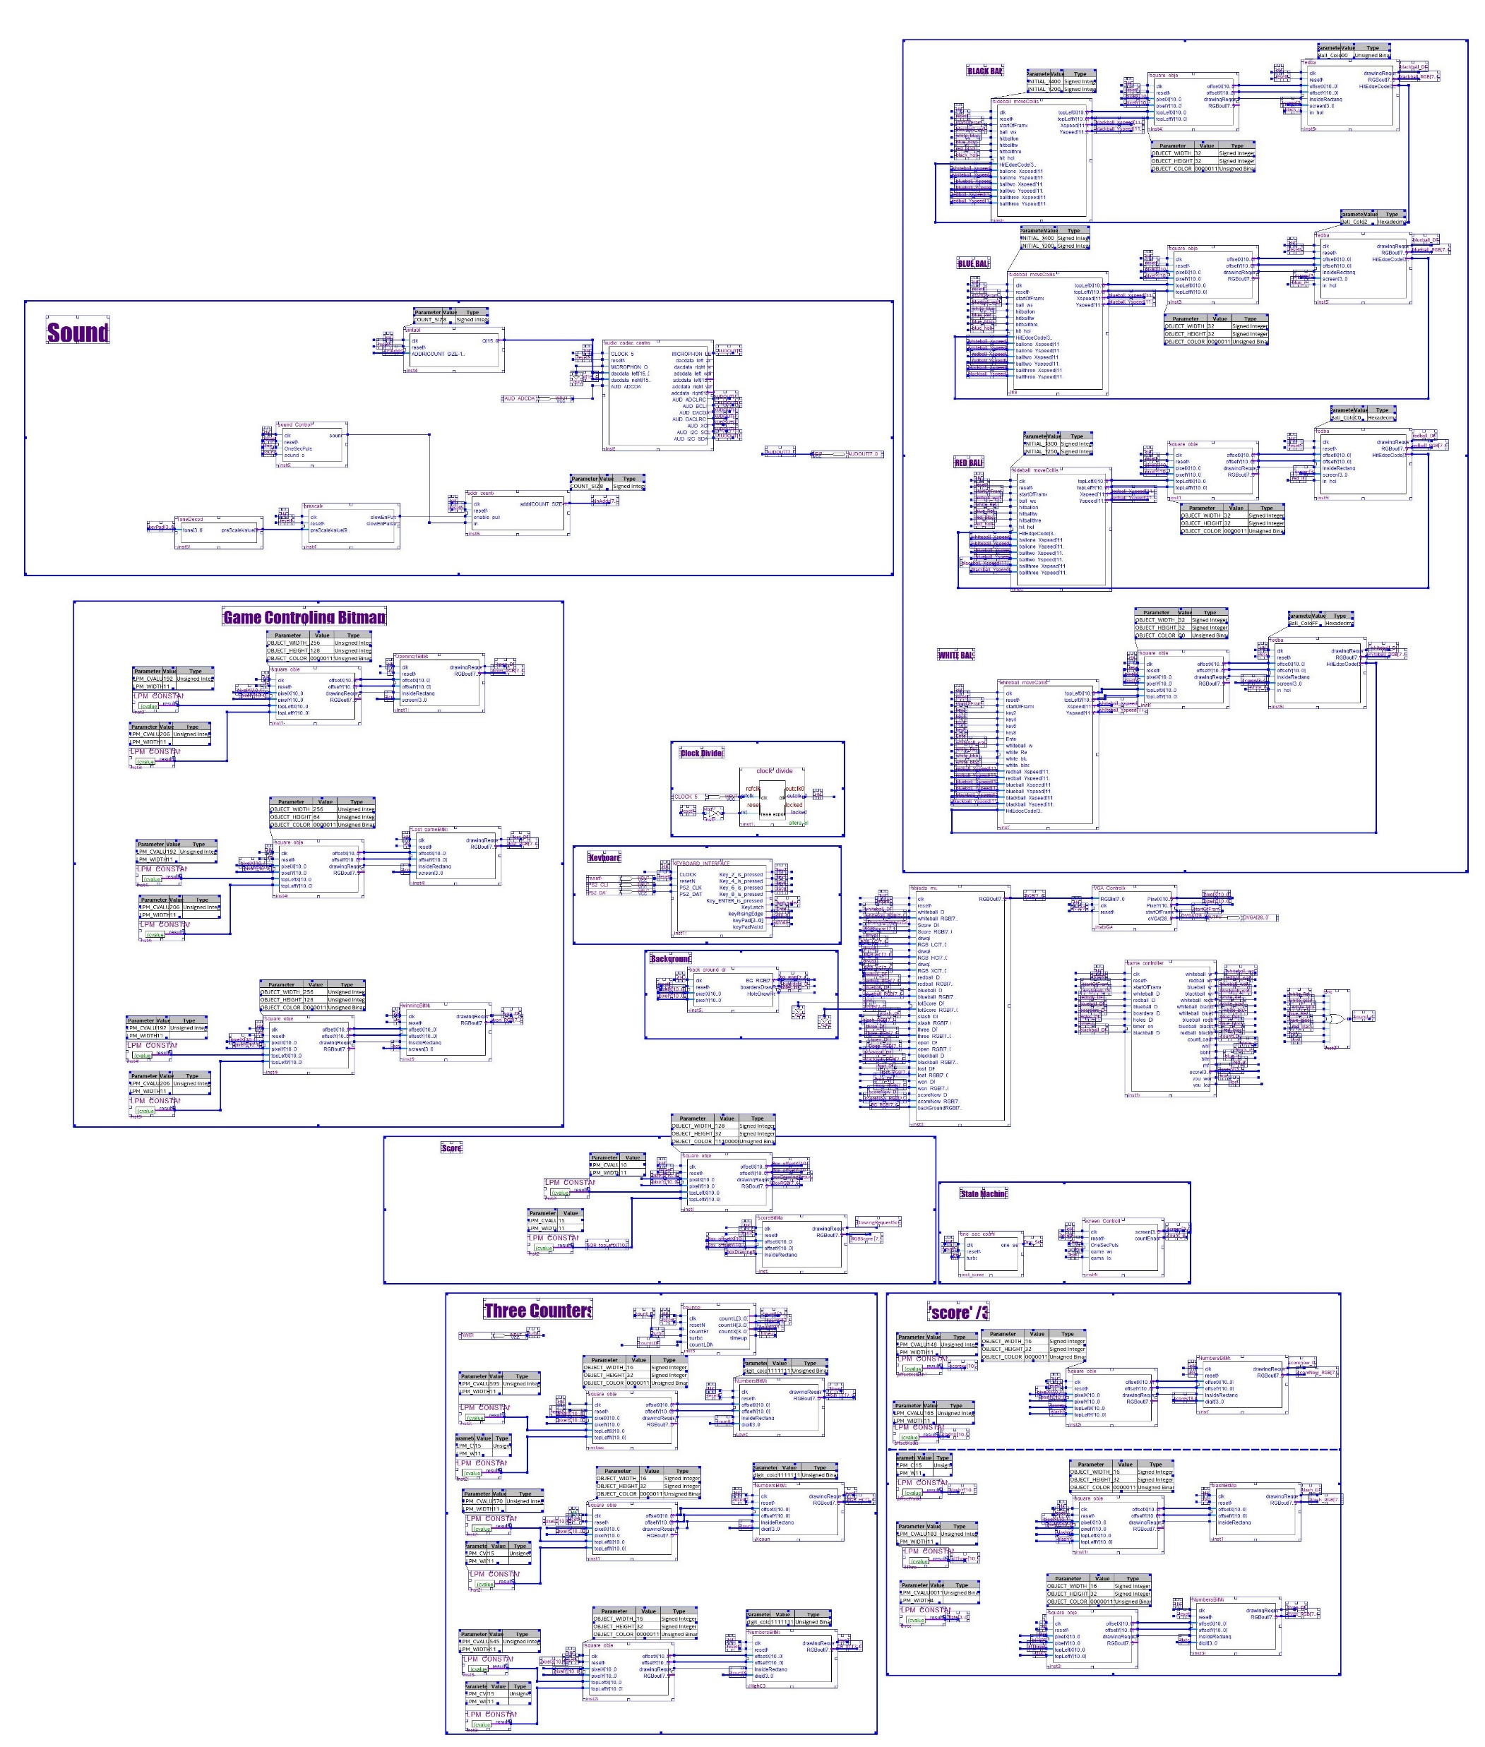
The Top BDF
White Ball
Sound
Side Ball
Timer
Score
Game Controller
Mux
Background

Slide 5

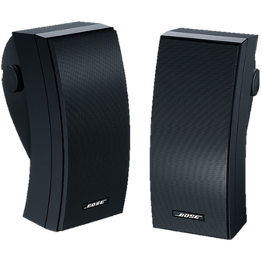

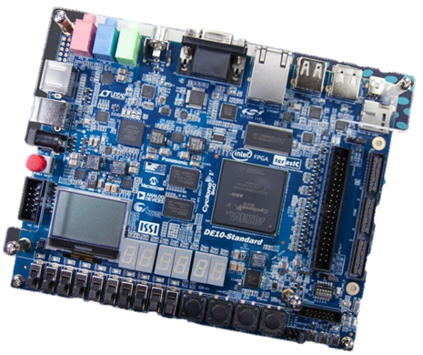
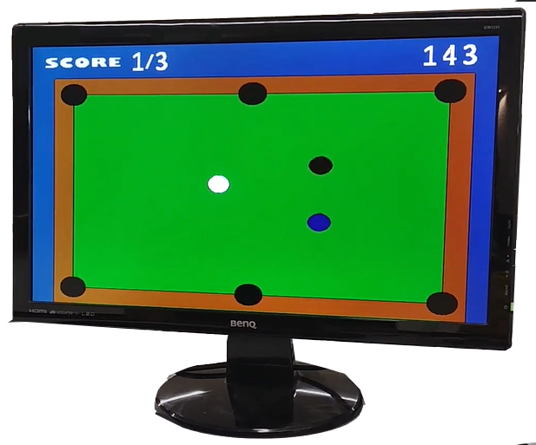
From Software to Hardware

Slide 6
Modules:
Screen_ Controller
Whiteball_moveCollision

Slide 7

Screen Controller:
State | Operation | Moving to next state
Idle | A state to initiate the game | After one second it moves to the start state
start | A starting screen with the message: ‘welcome, staring the game...’ | After 4 seconds it moves to the game state
game | Where the game rules come to work | As explained previously in the game rules
lose | A losing screen with the message: ‘you lost, reset to play again...’ | Waits for ResetN to start the game again
win | A winning screen with the message: ‘you won!, see you soon’ | Waits for ResetN to start the game again

Slide 8
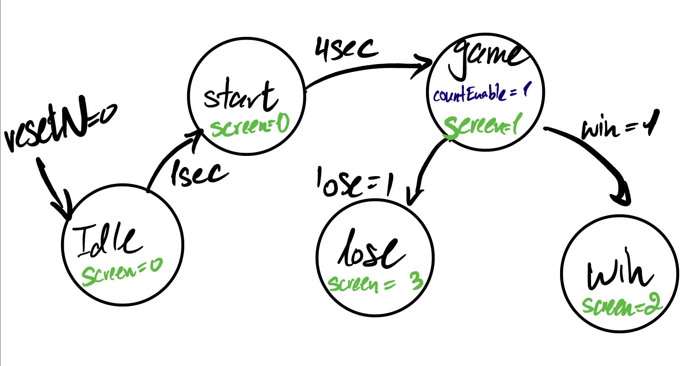
Bubble Diagram:

Slide 9
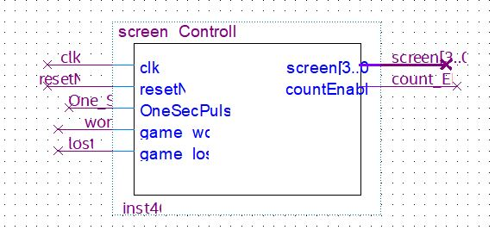
BDF:

Slide 10
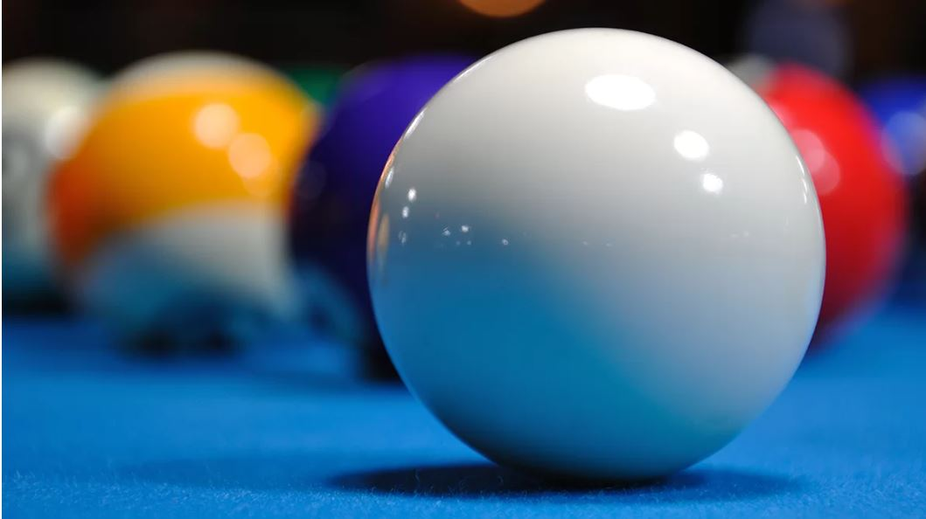
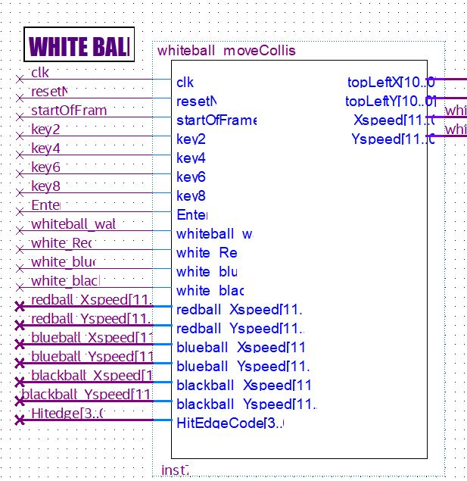
White Ball Move Collision:
Defining the initial placement.
Defining how the ball interacts with the keyboard interface.
Defining how the ball ‘absorbs’ the velocity of the others balls in case of a hit.
Defining how the friction works.

Slide 11
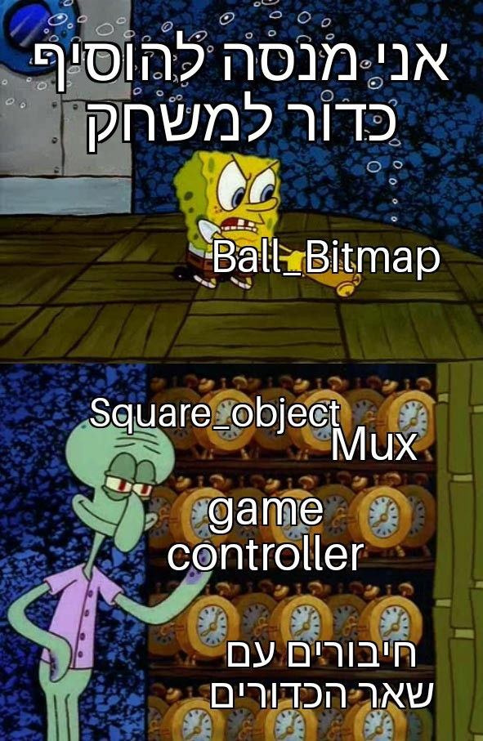
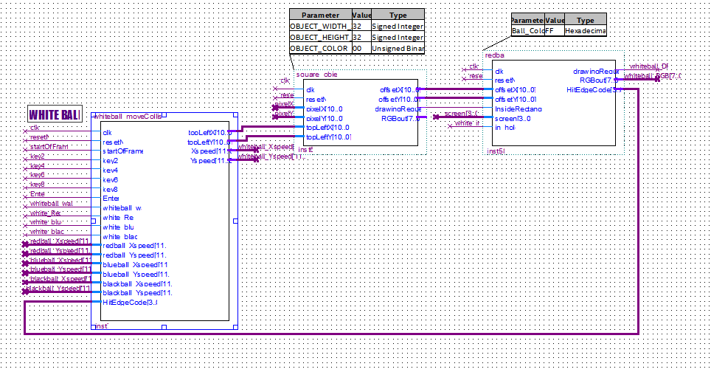
White Ball Block:

Slide 12
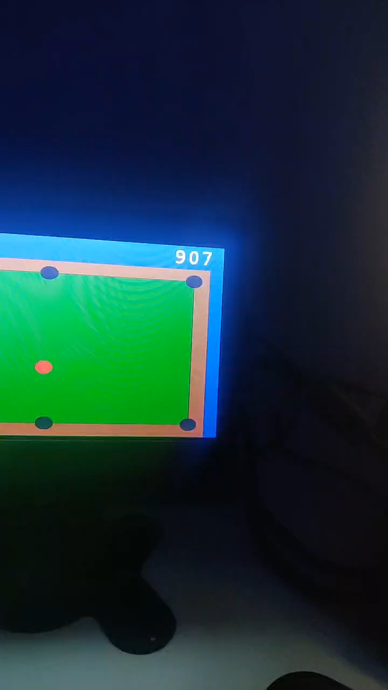
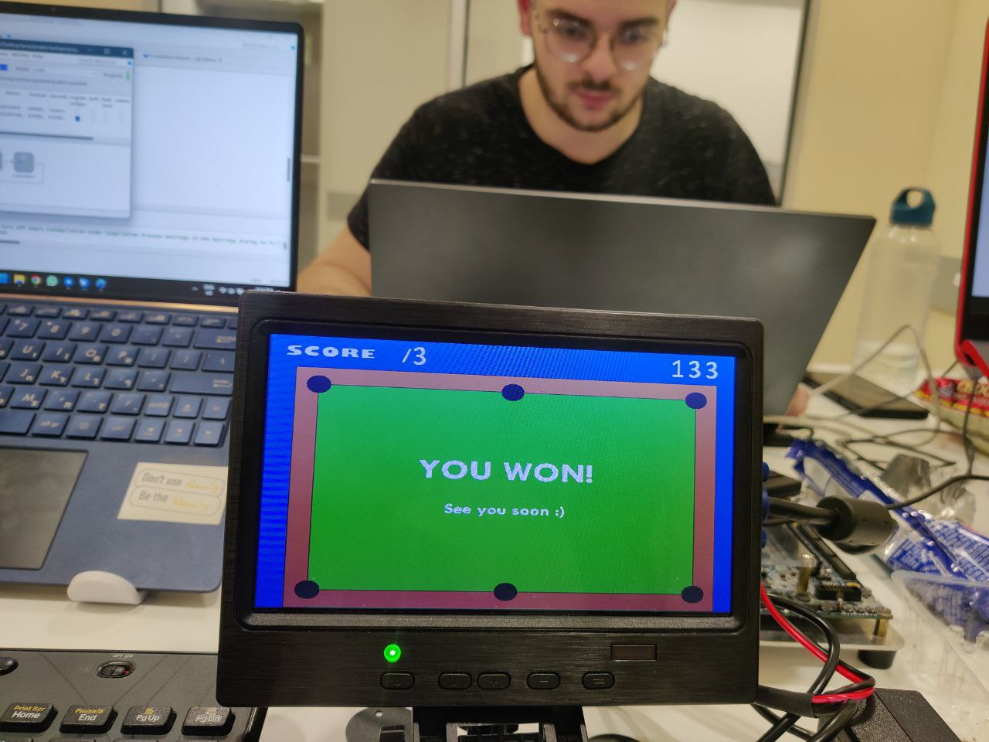
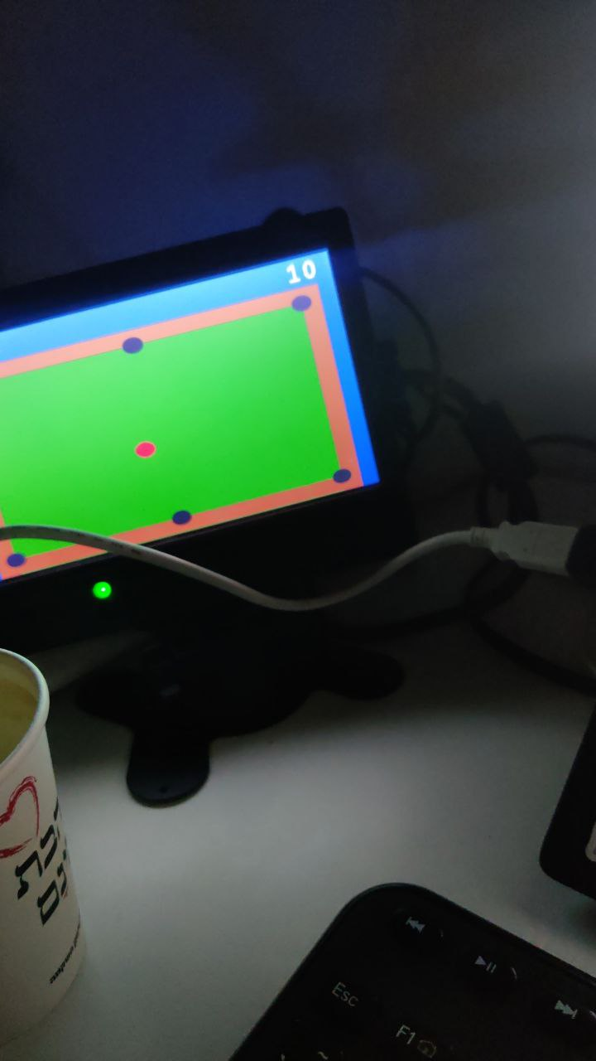
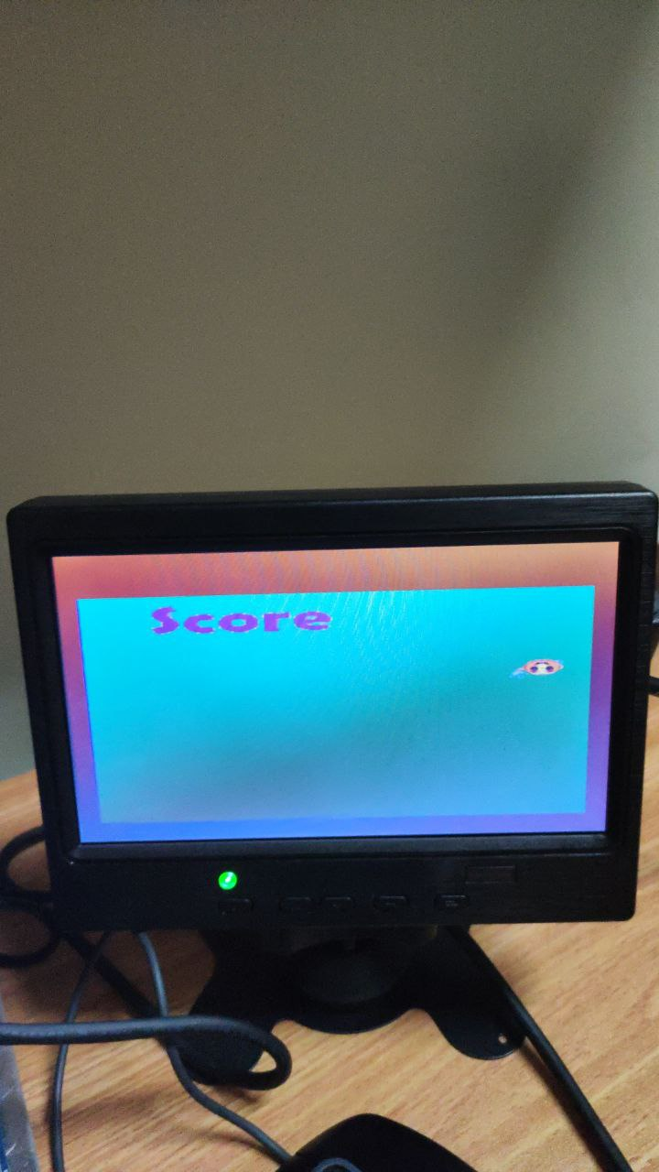
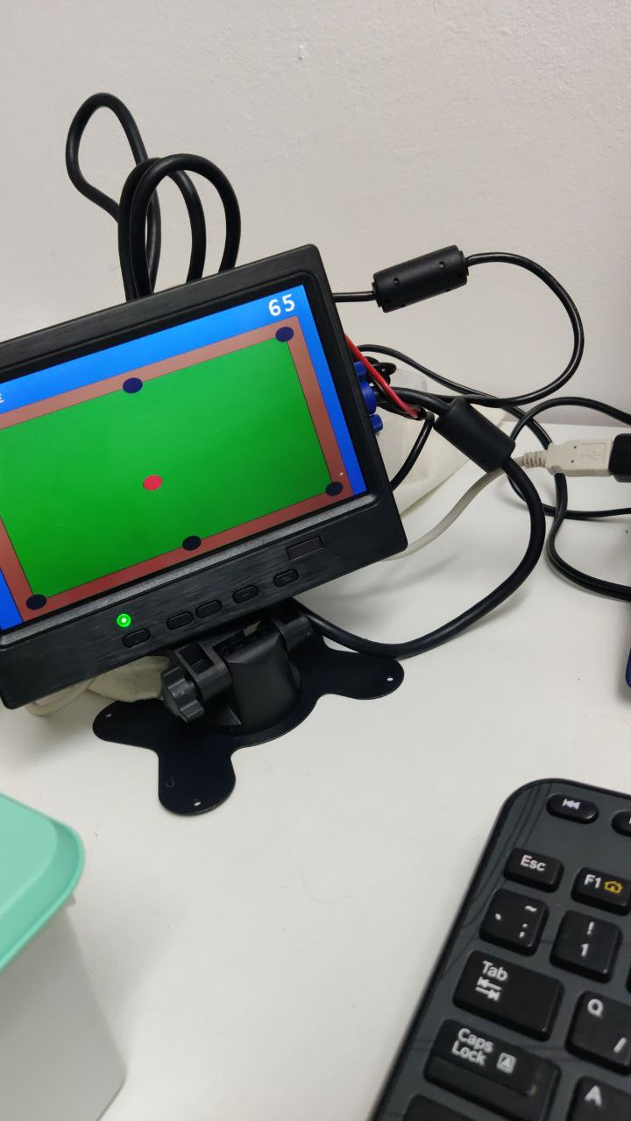
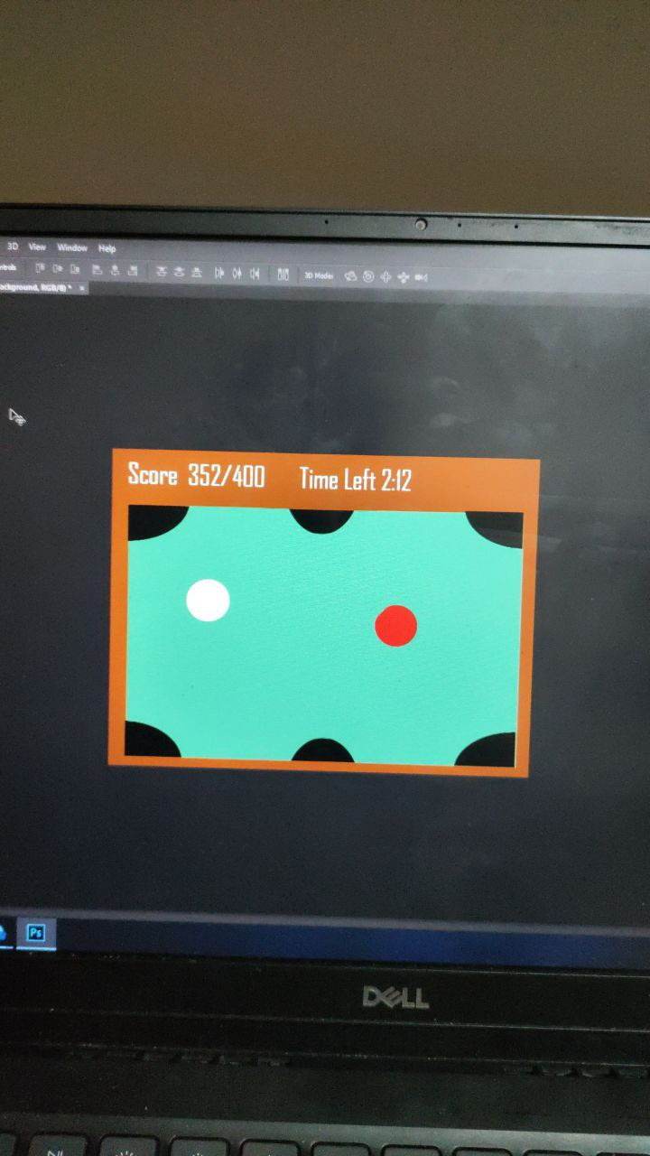
Evolution of the Project:

Slide 13
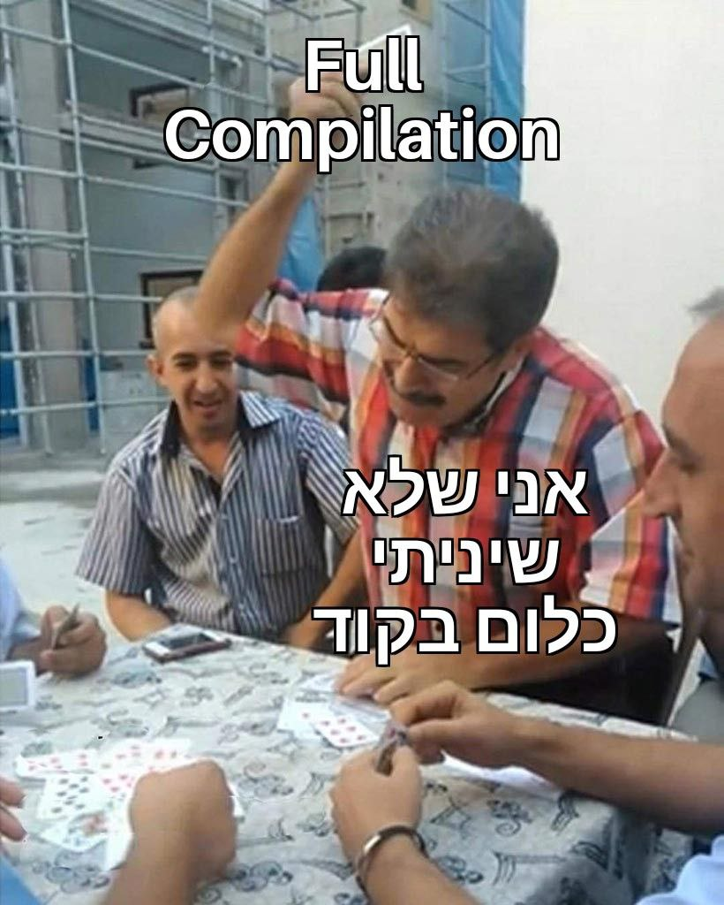
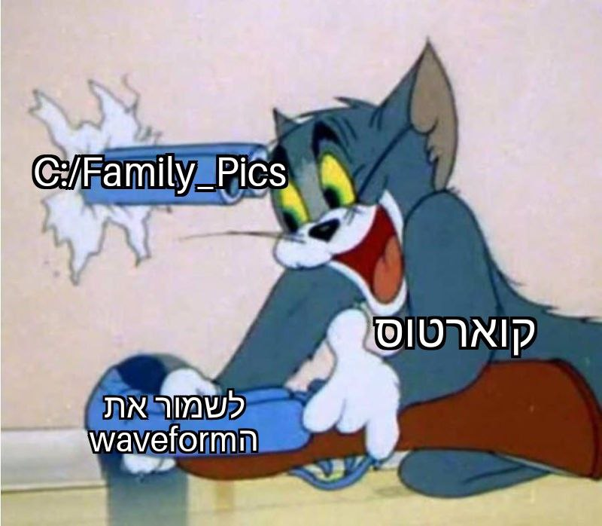
Conclusions:
To save the project as much as possible to not lose work.
When trying to save the waveform make sure it’s saved in the Quartus files.
Don’t waste time on unnecessary compilation.

Slide 14
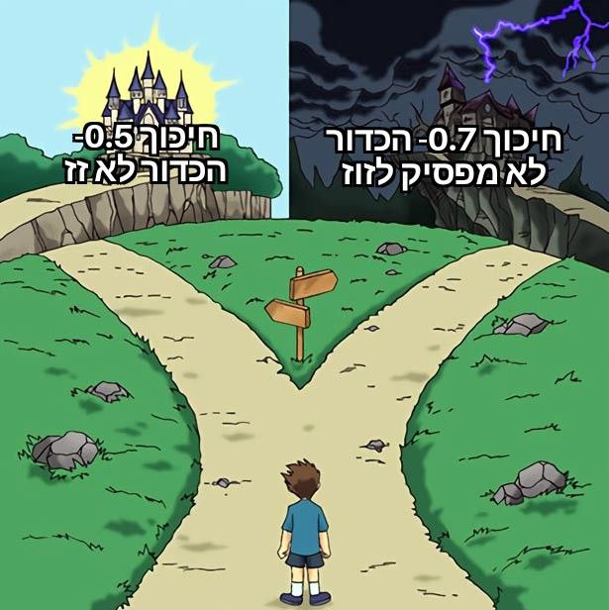
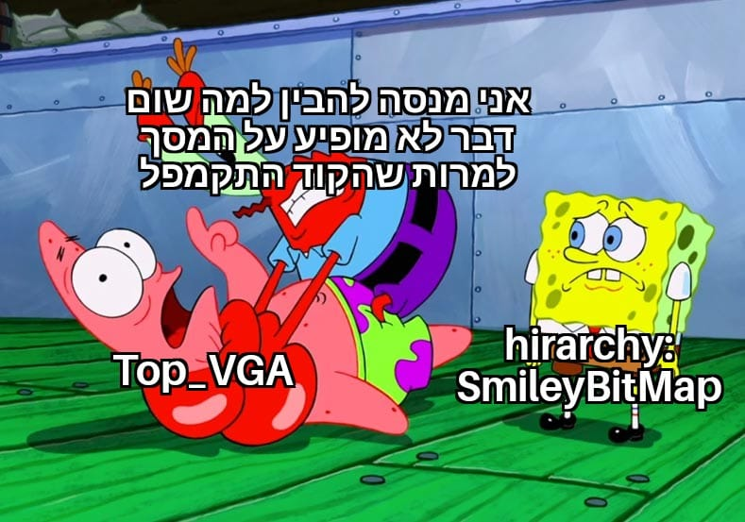
More Conclusions:
Make sure that your hierarchy is the top when compiling it to the VGA.
Sometimes we have to ‘learn it the hard way’.

Slide 15

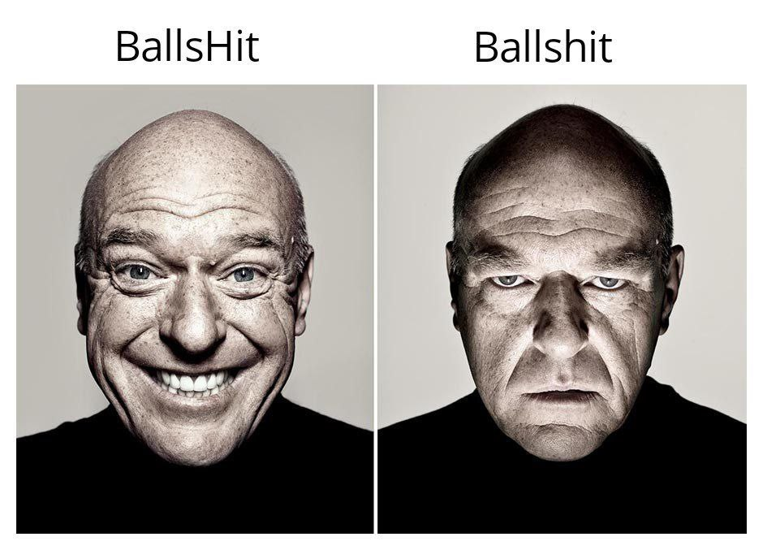
More Conclusions:
Well…
name wires properly
It’s okay to start with elaboration first, you don’t need to jump to full compilation all at once

Slide 16



Slide 17
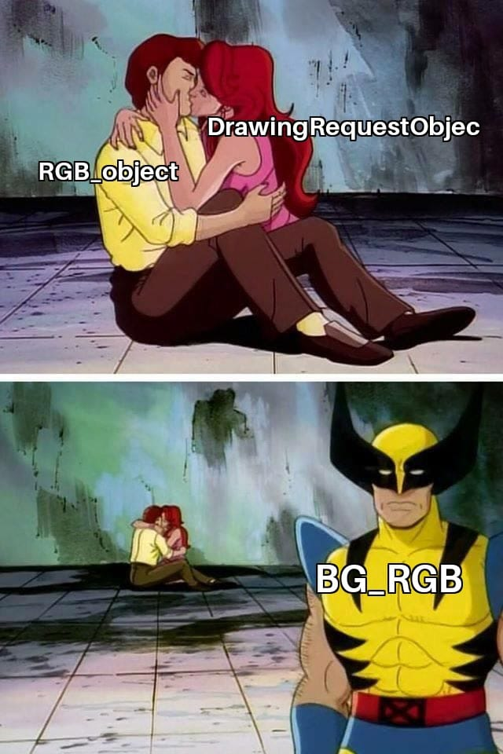
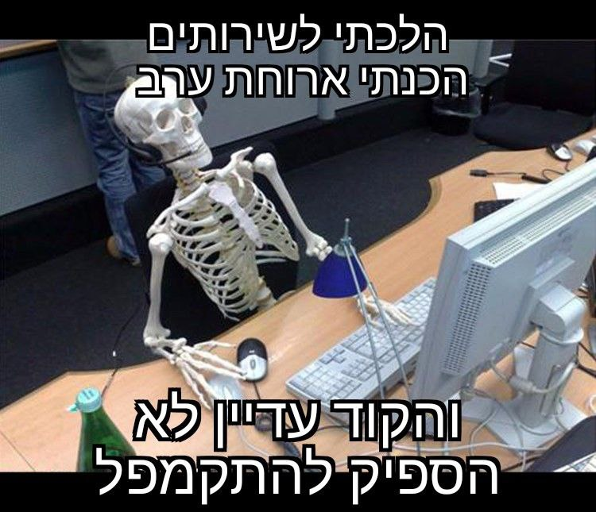

Slide 18


Slide 19
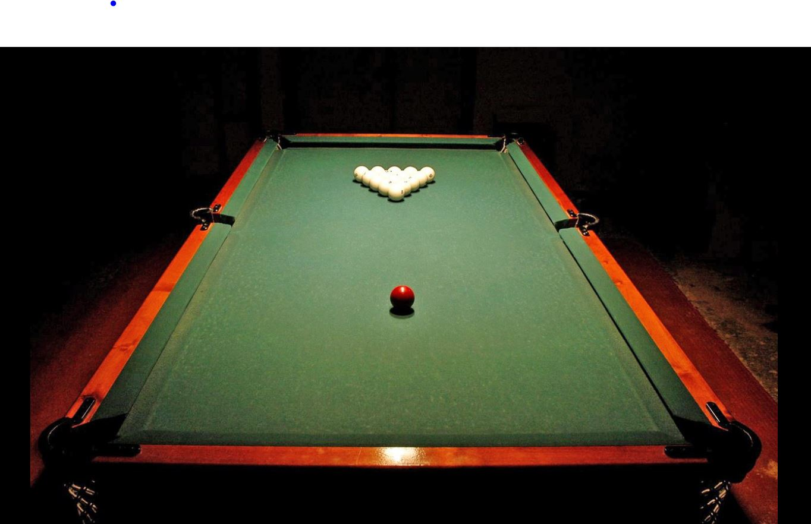
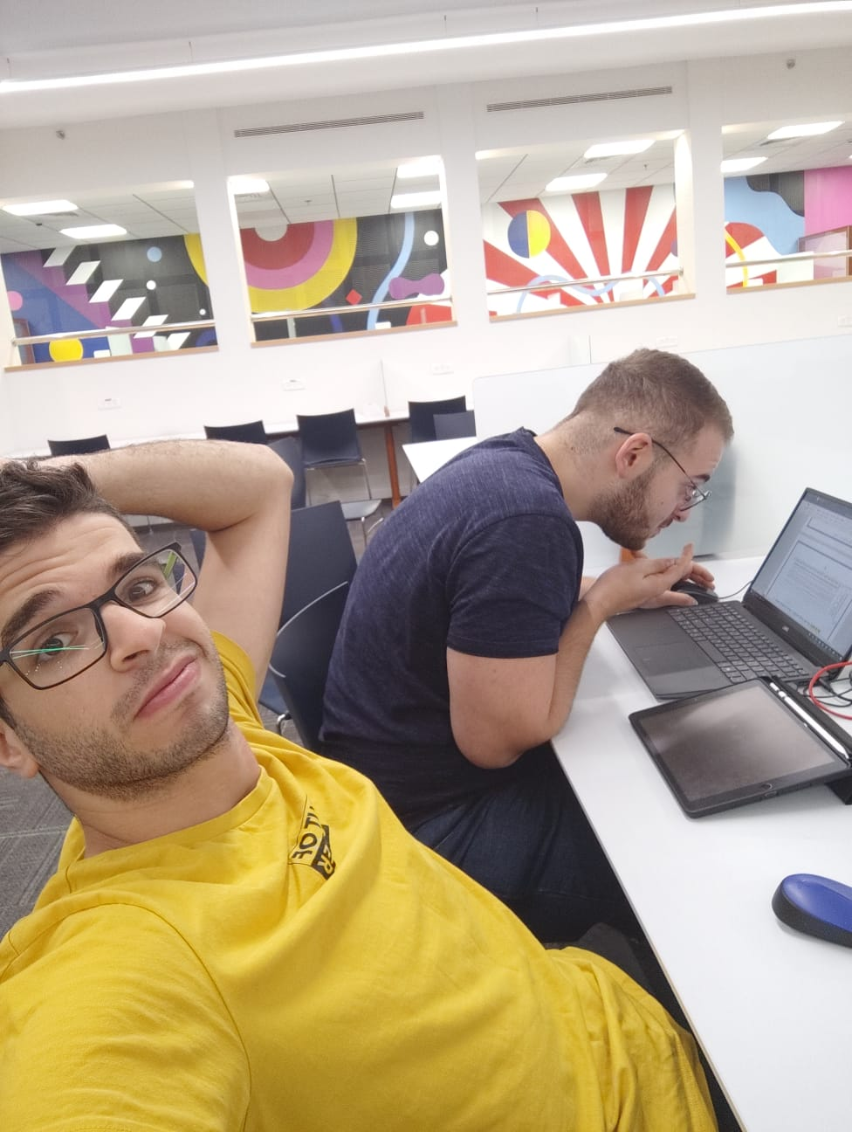
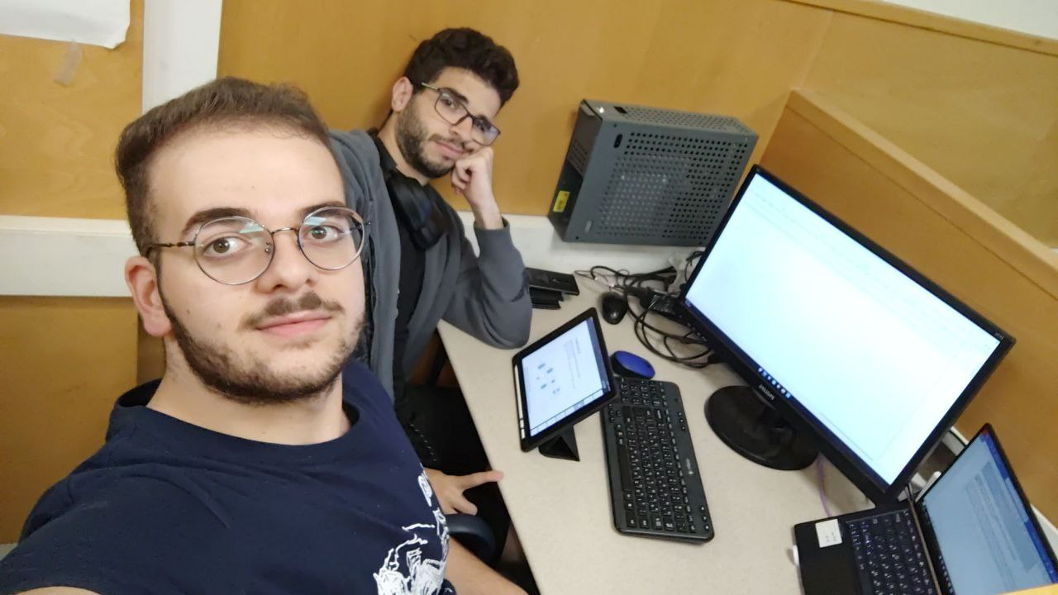
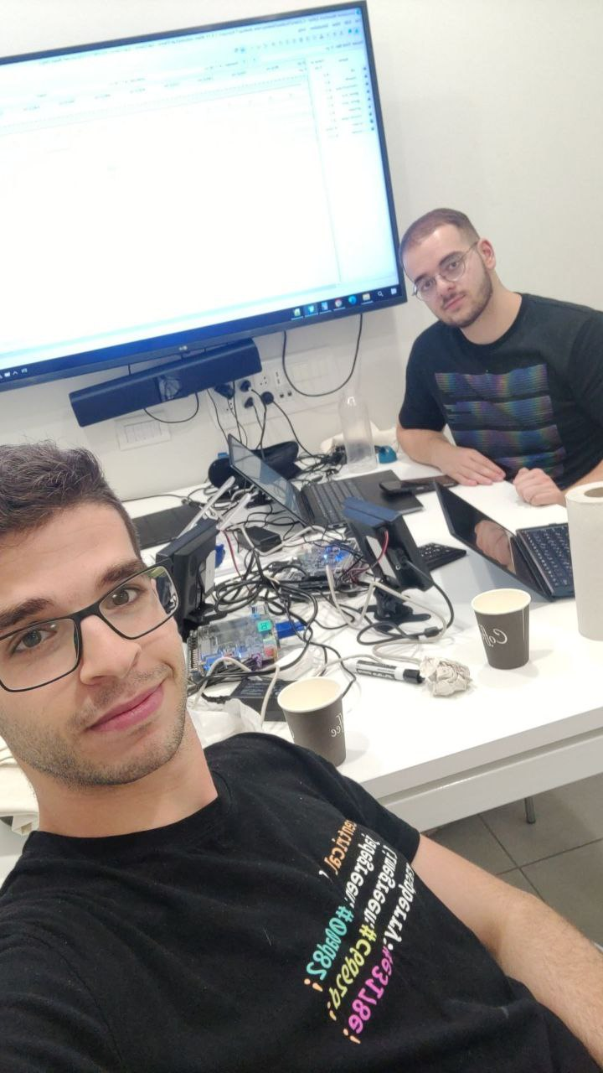
People go to the beach in summer
Us:

Slide 20
I bet you can’t wait to play the game!!

